Slide 1
Object Oriented Programming

Slide 2
Prerequisite
Fundamental of programming language I & II

Slide 3
Procedural Oriented Language
Conventional programming, using high-level language such as COBOL, FORTRAN and C are commonly known as Procedure oriented language (POP).
In POP numbers of functions are written to accomplish the tasks

Slide 4
Procedural Oriented Language - Structure -
Main program
Function-1
Function-2
Function-3
Function-4
Function-5
Function-6
Function-7
Function-8

Slide 5
Procedure Oriented Language - Characteristics -
Emphasis is on doing things (algorithms).
Larger programs are divided into smaller programs known as functions.
Most of the functions share global data.
Data move openly around the system from function to function.
Employs top-down approach in program design.

Slide 6
Procedural Oriented Language - Limitations -
Data move freely around the program and are therefore vulnerable to changes caused by any function in the program.
It does not model very well the real world problems.

Slide 7
Object Oriented Programming
OOP treats data as critical element
Ties data more closely to the functions that operate on it & allows decomposition of problem into objects.
OBJECT
Operations
Data
OBJECT
OBJECT
Operations
Data
Operations
Data
Communication

Slide 8
 | Procedure Oriented Programming | Object Oriented Programming
Divided Into | In POP, program is divided into small parts called functions | In OOP, program is divided into parts called objects
Importance | In POP, Importance is not given to data but to functions as well as sequence of actions to be done | In OOP, Importance is given to the data rather than procedures or functions because it works as a real world
Approach | POP follows Top Down approach | OOP follows Bottom Up approach
Access Specifiers | POP does not have any access specifier. | OOP has access specifiers named Public, Private, Protected, etc.
Data Moving | In POP, Data can move freely from function to function in the system | In OOP, objects can move and communicate with each other through member functions
Expansion | To add new data and function in POP is not so easy | OOP provides an easy way to add new data and function
Data Access | In POP, Most function uses Global data for sharing that can be accessed freely from function to function in the system | In OOP, data can not move easily from function to function, it can be kept public or private so we can control the access of data
Data Hiding | POP does not have any proper way for hiding data so it is less secure | OOP provides Data Hiding so provides more security
Examples | Example of POP are : C, VB, FORTRAN, Pascal | Example of OOP are : C++, JAVA, VB.NET, C#.NET

Slide 9
Fundamentals of OOP
Objects
Classes
Encapsulation
Data Abstraction
Inheritance
Polymorphism
Dynamic Binding
Message Passing

Slide 10
Objects
OOP uses objects as its fundamental building blocks.
Objects are the basic run-time entities in an object-oriented system.
Every object is associated with data and functions which define meaningful operations on that object.
Object is a real world existing entity.
Object is an Instance of a particular class.

Slide 11
Object
Operation
Attributes
Operation
Operation
Operation

Slide 12
Example: StudentObject
Enroll()
st_name
st_id
branch
semester
Performance()
Displayinfo()
Result()

Slide 13
Class
Class is a collection of similar objects.
Class

Slide 14
Encapsulation
It is a mechanism that associates the code and the data & it manipulates into a single unit and keeps them safe from external interference and misuse.

Slide 15
Encapsulation
Class: student
Attributes: st_name, st_id,
branch, semester
Functions: Enroll()
Displayinfo()
Result()
Performance()

Slide 16
Data Abstraction
A data abstraction is a simplified view of an object that includes only features one is interested in while hides away the unnecessary details.

Slide 17
Inheritance
Inheritance is the mechanism to provides the power of reusability and extendibility.
Inheritance is the process by which one object can acquire the properties of another
object.

Slide 18
Inheritance
Parent class
Or
Base class
Point
Child class
Or
Derived class
Line

Slide 19
Polymorphism
Polymorphism means that the same thing can exist in two forms.
Polymorphism is in short the ability to call different functions by just using one type of function call.

Slide 20
Polymorphism
5+9
Str + ing
+

Slide 21
Dynamic Binding
Dynamic Binding is the process of linking of the code associated with a procedure call at the run-time

Slide 22
Message Passing
The process of invoking an operation on an object.
In response to a message the corresponding method is executed in the object

Slide 23
Message Passing
StudentObject
FacultyObject
Performance
MgmtObject
Performance
Result

Slide 24
Variable Declaration
A variable defines a location in the memory that holds a value which can be modified later.
Syntax:
type variable_list;
In the above syntax "type" refers to any one of the C++ data types.

Slide 25
Declaring Variables
Variables in C++ should be declared before they are used in the code block.
#include <iostream.h>
void main()
{
int n = 10;
cout << "Integer value is:"<< n << '\n';
}
Result: Integer value is: 10 In the above example "n" is an integer variable declared using return type "int".

Slide 26
Rules for Naming variables in C++
Always the first character of a variable must be a letter or an underscore.
The variable name cannot start with a digit.
Other characters should be either letters, digits, underscores.
There is no limit for the length of variables.
Declared keywords cannot be used as a variable name.
Upper and lower case letters are distinct.

Slide 27
Variable Scope
A scope is a region of the program and broadly speaking there are three places, where variables can be declared:
Inside a function or a block which is called local variables,
In the definition of function parameters which is called formal parameters
Outside of all functions which is called global variables.

Slide 28
Local variables
Parameters and variables declared inside the definition of a function are local.
They only exist inside the function body.
Once the function returns, the variables no longer exist!

Slide 29
Example Using Local Variables:
#include <iostream.h>
int main ()
{ // Local variable declaration:
int a, b;
int c;
// actual initialization
a = 10;
b = 20;
c = a + b;
cout << c;
return 0;
}

Slide 30
Global Variables
We can declare variables outside of any function definition – these variables are global variables.
Any function can access/change global variables.
Example: flag that indicates whether debugging information should be printed.

Slide 31
Example Using Global and Local Variables
#include <iostream>
// Global variable declaration:
int g;
int main ()
{ // Local variable declaration:
int a, b;
// actual initialization
a = 10;
b = 20;
g = a + b;
cout << g;
return 0;
}

Slide 32
Constants (const)
Constants refer to fixed values that the program may not alter
Defining Constants:
Using #define preprocessor.
Using const keyword.

Slide 33
The #define Preprocessor:
Following is the form to use #define preprocessor to define a constant:
#define identifier value
Example
#include <iostream>
#define LENGTH 10
#define WIDTH 5
#define NEWLINE '\n'
int main()
{ int area;
area = LENGTH * WIDTH;
cout << area;
cout << NEWLINE;
return 0;
}
Result: 50

Slide 34
The const Keyword:
use const prefix to declare constants with a specific type as follows:
const type variable = value;
Example:-
#include <iostream.h>
int main()
{
const int LENGTH = 10;
const int WIDTH = 5;
const char NEWLINE = '\n';
int area;
area = LENGTH * WIDTH;
cout << area;
cout << NEWLINE;
return 0;
}
Output:50

Slide 35
Reference Variable
Variable name as a label attached to the variable's location in memory.
Reference as a second label attached to that memory location.
Access the contents of the variable through either the original variable name or the reference.
Syntax:
Data-type & reference name = variable name

Slide 36
For example
int i = 17;
We can declare reference variables for i as follows.
int& r = i;
the & in this declaration is as reference.
Read declaration as "r is an integer reference initialized to i"

Slide 37
Example
#include <iostream>
int main ()
{
// declare simple variables
int i; double d;
// declare reference variables
int& r = i;
double& s = d;
i = 5;
cout << "Value of i : " << i << endl;
cout << "Value of i reference : " << r << endl;
d = 11.7;
cout << "Value of d : " << d << endl;
cout << "Value of d reference : " << s << endl;
return 0;
}
Output:
Value of i : 5
Value of i reference : 5
Value of d : 11.7
Value of d reference : 11.7

Slide 38
Comments in C++
Program comments are explanatory statements that you can include in the C++ code that you write and helps anyone reading it's source code.
C++ supports single-line and multi-line comments. All characters available inside any comment are ignored by C++ compiler.

Slide 39
C++ comments start with /* and end with */. For example:
/* This is a comment */
/* C++ comments can also
* span multiple lines
*/

Slide 40
A comment can also start with //, extending to the end of the line.
For example:
#include <iostream.h>
main()
{
cout << "Hello World"; // prints Hello World
return 0;
}
Output : Hello World

Slide 41
Default Parameter
C++ allows to call function without specifying all its arguments
Functions assigns default value to parameter which does not have matching argument in function call
Specified when function is declared

Slide 42
Default parameter (Example)
Float amount(float principal, float period, float rate=0.15)
Default value 0.15 to parameter rate
Function call like
value = amount (5000,7); //one parameter missing
Passes 0.15 to rate
Now,
value =amount(5000,7,0.12) //no missing argument
Passes explicit value 0.12 to rate

Slide 43
#include<iostream.h>
#include<conio.h>
int vol(int=1,int=2,int=3);
main() {
clrscr();
int length; int width; int height;
int volume;
cout<<"\n Enter length = ";
cin>>length;
cout<<"\n Enter width = ";
cin>>width;
cout<<"\n Enter heigth = ";
cin>>height;
volume=vol();
cout<<"\n Volume with no argument passed ="<<volume;
volume=vol(length);
cout<<"\n Volume with one argument passed = "<<volume; volume=vol(length,width);
getch();
return 0; }
Output:
Enter Length:6
Enter width:5
Enter height: 9
Volume with no argument passed =6
Volume with one argument passed=36
int vol(int l,int h,int w)
{
return l*h*w;
}

Slide 44
C++ Functions
Set of program statements that can be processed independently.
Like in other languages, called subroutines or procedures.

Slide 45
Advantages …?
Elimination of redundant code
Easier debugging
Reduction in the Size of the code
Leads to reusability of the code
Achievement of Procedure Abstraction

Slide 46
Function Prototype
Is a declaration statement in program
Syntax:
Return type function name (parameter list);

Slide 47
Sample function
Formal parameters
Return type
Function name
int add_int(int a, int b)
{
return(a+b);
}
Function body

Slide 48
Function Overloading
Multiple functions to share the same name with different signatures(types or numbers).
int myfunc(int i)
{
return i;
}
int myfunc(int i, int j)
{
return i*j;
}

Slide 49
Disadvantages of using function
Every time a function is called, it take a lot of extra time in executing a series of instructions.
In the following ways of execution it takes more time
Jumping to the function
Saving in Register.
Pushing arguments into the stack.
Returning to the calling function.

Slide 50
Inline Functions
Inline functions are those whose function body is inserted in place of the function call statement during the compilation process.
Syntax:
inline returntype func_name(formal parameters)
{
function body
}

Slide 51
Inline function
C++ inline function is powerful concept that is commonly used with classes
If a function is inline, the compiler places a copy of the code of that function at each point where the function is called at compile time.
Any change to an inline function could require all clients of the function to be recompiled because compiler would need to replace all the code once again otherwise it will continue with old functionality.
To inline a function, place the keyword inline before the function name and define the function before any calls are made to the function
The compiler can ignore the inline qualifier in case defined function is more than a line.

Slide 52
Inline (cntd…)
A function definition in a class definition is an inline function definition, even without the use of the inline specifier
#include <iostream>
using namespace std;
inline int Max(int x, int y)
{
return (x > y)? x : y;
}
// Main function for the program
int main( )
{
cout << "Max (20,10): " << Max(20,10) << endl;
cout << "Max (0,200): " << Max(0,200) << endl;
cout << "Max (100,1010): " << Max(100,1010) << endl;
return 0;
}

Slide 53
output
Max (20,10): 20
Max (0,200): 200
Max (100,1010): 1010

Slide 54
C++ Overview

Slide 55
Structure of C++ Program
Include Files
Class Definition
Class Function Definition
Main Function Program

Slide 56
Simple C++ Program
// Hello World program
#include <iostream.h>
int main() {
cout << "Hello World\n";
return 0;
}
comment
Allows access to an I/O library
Starts definition of special function main()
output (print) a string
Program returns a status code (0 means OK)

Slide 57
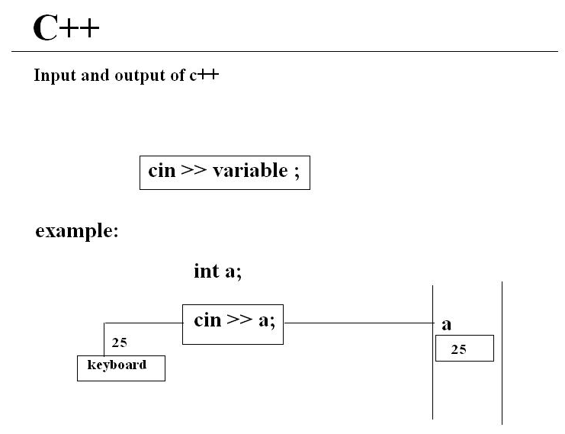
>> :- Input using Extraction operator

Slide 58
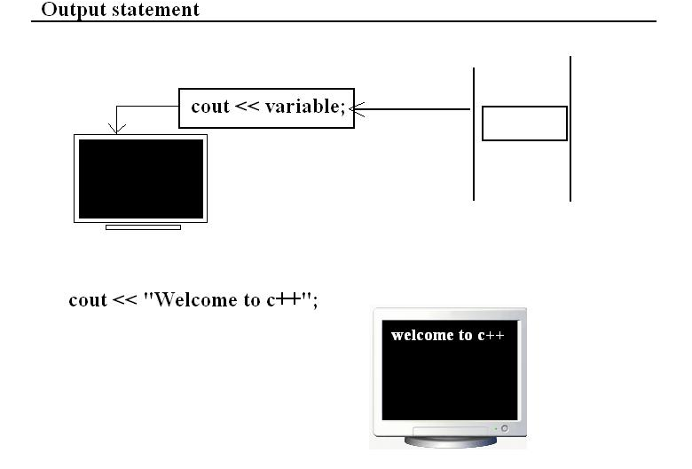
C++
Output using insertion operator

Slide 59
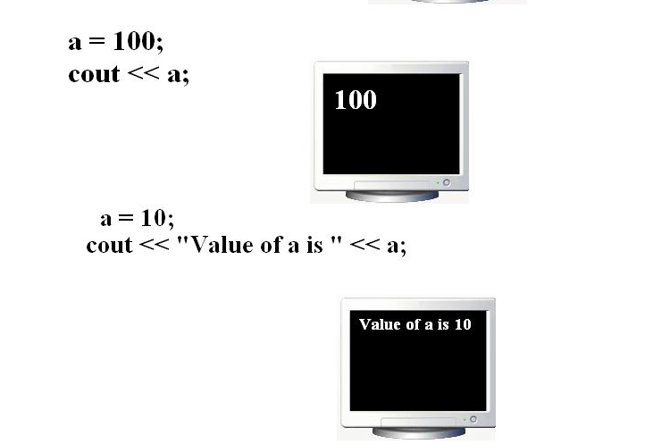

Slide 60
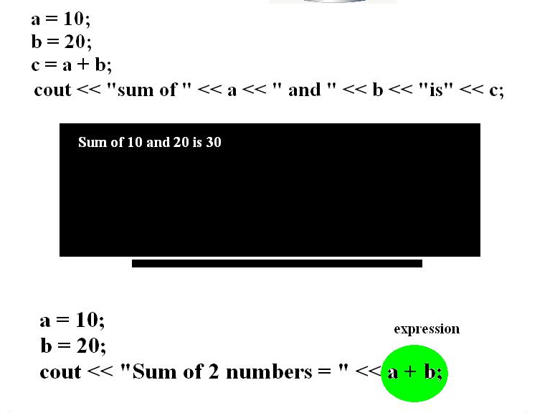

Slide 61
Memory Management Operator
New and delete operators are used to allocate and free the memory
Object can be created by using new and deleted by using delete operator
Syntax:
Pointer variable = new data-type

Slide 62
Example
Int *p=new int;
Float *q=new float;
Suppose
*p=25
*q=7.5

Slide 63
Data object no longer needed, it is destroyed to release memory space for reuse.
Syntax
delete pointer variable
Example :
delete q;
delete p;

Slide 64
Defining Class

Slide 65
Class Specification
Syntax:
class class_name
{
};
Data members
Members functions

Slide 66
Class Specification
class Student
{
int st_id;
char st_name[];
void read_data();
void print_data();
};
Data Members or Properties of Student Class
Members Functions or Behaviours of Student Class

Slide 67
Class Specification
Visibility of Data members & Member functions
Public –
Accessed by member functions and all other non-member functions in the program.
Private –
Accessed by only member functions of the class.
Protected –
Similar to private, but accessed by all the member functions of immediate derived class
Default –
All items defined in the class are private.

Slide 68
Class Specification
class Student
{
int st_id;
char st_name[];
void read_data();
void print_data();
};
private / default
visibility

Slide 69
Class Specification
class Student
{
public:
int st_id;
char st_name[];
public:
void read_data();
void print_data();
};
public visibility

Slide 70
Class Objects
Object Instantiation:
The process of creating object of the type class
Syntax:
class_name obj_name;
ex: Student st;
Creates a single object of the type Student!
St_id, St_name
void read_data( )
void print_data( )

Slide 71
Class Object
More of Objects
ex: Student st1;
Student st2;
Student st3;

Slide 72
Class Objects
10,Rama
20, Stephen
void read_data( )
void read_data( )
void print_data( )
void print_data( )
st1
st2
55, Mary
void read_data( )
void print_data( )
st3

Slide 73
Arrays of Objects
Several objects of the same class can be declared as an array and used just like an array of any other data type.
The syntax for declaring and using an object array is exactly the same as it is for any other type of array.

Slide 74
Class Objects
S[0]
33, Joseph
S[0]
S[1]
S[2]
S[3]
S[4]
S[5]
S[6]
S[7]
Array of Objects
ex: Student s[8];
void read_data( )
void print_data( )
24, Sakshi
void read_data( )
void print_data( )
S[4]

Slide 75
Accessing Data Members (inside the class)
Syntax: (single object)
data_member;
ex: st_id;
Syntax:(array of objects)
data_member;
ex: st_id;

Slide 76
Accessing Data Members (outside the class)
Syntax: (single object)
obj_name . datamember;
ex: st.st_id;
Syntax:(array of objects)
obj_name[i] . datamember;
ex: st[i].st_id;

Slide 77
Defining Member Functions (Inside the class definition)
Syntax
ret_type fun_name(formal parameters)
{
function body
}

Slide 78
Defining Member Functions (Outside the class definition)
Syntax
ret_type class_name::fun_name(formal parameters)
{
function body
}

Slide 79
Accessing Member Functions
Syntax: (single object)
obj_name . Memberfunction(act_parameters);
ex: st.read( );
Syntax:(array of objects)
obj_name[i] . Memberfunction(act_parameters);
ex: st[i].read( );

Slide 80
Inline Functions with Class
Syntax: (Inside the class definition)
inline ret_type fun_name(formal parameters)
{
function body
}

Slide 81
Inline Functions with Class
Syntax: (Outside the class definition)
inline ret_type class_name::fun_name (formal parameters)
{
function body
}

Slide 82
Static Data Members
Static data members of a class are also known as "class variables“.
Because their content does not depend on any object.
They have only one unique value for all the objects of that same class.

Slide 83
Static Data Members
Tells the compiler that only one copy of the variable will exist and all objects of the class will share that variable.
Static variables are initialized to zero before the first object is created.
Static members have the same properties as global variables but they enjoy class scope.

Slide 84
Static Member Functions
Member functions that are declared with static specifier.
Syntax:
class class_name
{
public:
static ret_dt fun_name(formal parameters);
};

Slide 85
Static Member Functions
Special features:
They can directly refer to static members of the class.
They can be called using class name like..
Class name::function name;

Slide 86
int main()
{
test t1,t2;
t1.setcode();
t2.setcode();
test::showcount();
test t3;
t3.setcode();
test::showcount();
t1.showcode();
t2.showcode();
t3.showcode();
Return 0;
}
#include < iostream>
Class test
{
Int code;
Static int count;
Public:
Void setcode(void)
{ code=++count;}
Void showcode(void)
{ cout<<“object no.:”<<code;}
Static void showcount(void)
{ cout<<“count:”<<count; }
};
Int test::count;
Output
Count:2
Count :3
Object number:1
Object number:2
Object number:3

Slide 87
Constructors
A constructor function is a special member function that is a member of a class and has the same name as that class, used to create, and initialize objects of the class.
Constructor function do not have return type.
Should be declared in public section.
Invoked automatically when objects are created

Slide 88
Constructors
Example:
class student
{ int st_id;
public:
student()
{
st_id=0;
}
};
Syntax:
class class_name
{
public:
class_name();
};

Slide 89
Constructors
How to call this special function…?
class student
{
int st_id;
public:
student()
{
st_id=0;
}
};
int main()
{
student st;
…………
…………
};

Slide 90
Types of Constructors
Parameterized constructors
Constructors with default argument
Copy constructors
Dynamic constructors

Slide 91
Parameterized Constructors
class Addition
{
int num1;
int num2;
int res;
public:
Addition(int a, int b); // constructor
void add( );
void print();
};
Constructor with parameters B’Coz it’s also a function!
Constructor that can take arguments is called parameterized constructor.

Slide 92
Overloaded Constructors
class Addition
{
int num1,num2,res;
float num3, num4, f_res;
public:
Addition(int a, int b); // int constructor
Addition(float m, float n); //float constructor
void add_int( );
void add_float();
void print();
};
Overloaded Constructor with parameters B’Coz they are also functions!

Slide 93
Constructors with Default Argument
class Addition
{
int num1;
int num2;
int res;
public:
Addition(int a, int b=0); // constructor
void add( );
void print();
};
Constructor with default parameter.

Slide 94
Copy Constructor
class code
{
int id;
public:
code() //constructor
{ id=100;}
code(code &obj) // constructor
{
id=obj.id;
}
void display()
{
cout<<id;
}
};
int main()
{ code A(100);
code B(A);
code C=A;
code D;
D=A; // wrong syntax for copy construcor
cout<<“ id of A:”; A.display();
cout<<“ id of B:”; B.display();
cout<<“ id of C:”; C.display();
cout<<“ id of D:”; D.display();
}
Copy constructor is used to declare and initialize an object from another object

Slide 95
Dynamic Constructors
Used to allocate memory at the time of object creation
class Sum_Array
{
int *p;
public:
Sum_Array(int sz) // constructor
{
p=new int[sz];
}
};

Slide 96
Destructors
A destructor function is a special function that is a member of a class and has the same name as that class used to destroy the objects.
Must be declared in public section.
Destructor do not have arguments & return type.
NOTE:
A class can have ONLY ONE destructor

Slide 97
Destructors
Synatax:
class class_name
{
public:
~class_name();
};
Example:
class student
{
public:
~student()
{
cout<<“Destructor”;
}
};

Slide 98
Local Classes
A class defined within a function is called Local Class.
void fun()
{
class myclass {
int i;
public:
void put_i(int n) { i=n; }
int get_i() { return i; }
} ob;
ob.put_i(10);
cout << ob.get_i();
}
Syntax:
void function()
{
class class_name
{
// class definition
} obj;
//function body
}

Slide 99
Multiple Classes
Syntax:
class class_name1
{
//class definition
};
class class_name2
{
//class definition
};
Example:
class test
{
public:
int t[3];
};
Example:
class student
{ int st_id;
test m;
public:
void init_test()
{
m.t[0]=25;
m.t[1]=22;
m.t[2]=24;
}
};

Slide 100
Nested Classes
Syntax:
class outer_class
{
//class definition
class inner_class
{
//class definition
};
};
Example:
class student
{ int st_id;
public:
class dob
{ public:
int dd,mm,yy;
}dt;
void read()
{
dt.dd=25;
dt.mm=2;
dt.yy=1988;}
};

Slide 101
Friend Functions
A friend function of a class is defined outside that class' scope but it has the right to access all private and protected members of the class.
To declare a friend function, its prototype should be included within the class, preceding it with the keyword friend.

Slide 102
Friend Functions
Example:
class myclass
{
int a, b;
public:
friend int sum(myclass x);
void set_val(int i, int j);
};
Syntax:
class class_name
{
//class definition
public:
friend rdt fun_name(formal parameters);
};

Slide 103
#include <iostream>
using namespace std;
class Box
{
double width;
public:
friend void printWidth( Box box );
void setWidth( double wid );
};
// Member function definition
void Box::setWidth( double wid )
{
width = wid; }
void printWidth( Box box ) // Note: printWidth() is not a member function of any class.
{
/* Because printWidth() is a friend of Box, it can directly access any member of this class */
cout << "Width of box : " << box.width <<endl; }
// Main function for the program
int main()
{
Box box; // set box width without member function
box.setWidth(10.0);
printWidth( box ); // Use friend function to print the width.
return 0; }

Slide 104
Friend Function
Characteristics:
Not in the scope of class to which it has been declared as friend
It can not be called using object of class
Invoked like normal function
Can not access data members directly, has to use object and dot operator
Can be declare in private or public section.
It has objects as arguments.

Slide 105
Void max (XYZ m,ABC n)
{
If(m.x>=n.a)
Cout<<m.x;
Else
Cout<<n.a;
}
Int main()
{
ABC h;
h.setvalue(10);
XYZ j;
j.setvalue(20);
Max(h,j)
}
#include<iostream>
Class ABC;
Class XYZ
{ int x;
Public:
Void setvalue(int i) {x=i;}
Friend void max(XYZ,ABC);
};
Class ABC
{ int a;
Public:
Void setvalue(int i) {a=i;}
Friend void max(XYZ,ABC);
};
Output
20

Slide 106
Pointers to Objects
student st;
51, Rajesh
student *ptr;
void read_data( )
ptr = & st;
void print_data( )
st
2FCD54
ptr

Slide 107
Pointers to Objects
Pointers can be defined to hold the address of an object, which is created statically or dynamically
Statically created object:
student *stp;
stp = &st;
33, Joseph
void read_data( )
Dynamically created object:
student *stp;
stp = new student;
void print_data( )
st
2FCDA4

Slide 108
Pointers to Objects
Accessing Members of objects:
Syntax:
ptr_obj→member_name;
ptr_obj→memberfunction_name( );
Example:
stp→st_name;
stp→read_data( );

Slide 109
The this Pointer
The this pointer points to the object that invoked the function
When a member function is called with an object, it is automatically passed an implicit argument that is a pointer to the invoking object (that is, the object on which the function is called).

Slide 110
The this Pointer
Accessing Members of objects:
Syntax:
obj . memberfunction_name( );
Example:
st . read_data ( );
this pointer points to st object

Slide 111
Pointer to Class Member
A special type of pointer that "points“ generically to a member of a class, not to a specific instance of that member in an object
Pointer to a class member is also called pointer-to-member.

Slide 112
Pointer to Class Member
It provides only an offset into an object of the member's class at which that member can be found.
Member pointers are not true pointers, the . and -> cannot be applied to them.
A pointer to a member is not the same as a normal C++ pointer.

Slide 113
Pointer to Class Member
To access a member of a class:
Special pointer-to-member operators
.*
–>*

Slide 114
Pointer to Class Member
Syntax to create pointer to data member
of a class:
Data_type class_name ::* data_member_ptr;
int student::*d_ptr;
Syntax to create pointer to member function
of a class:
rtn_dt (class_name::* mem_func_ptr)(arguments);
int (student::*f_ptr)();

Slide 115
Thank you

